Slide 1
QA Individual Project: IMS
Aim of the project?
Luke Smyth-Osbourne

Slide 2
Intro:
Methodology – processes and tools used
Product demo
Questions
https://github.com/users/sosbourneQA/projects/1

Slide 3
Topics Covered
SQL:
DDL (Data Definition Language)
DML(Data Manipulation Language)
GCP
Java:
OOP
SOLID – Single responsibility, Open/closed, Liskokv Substitution, Interface Segragation, Dependancy inversion
CRUD – Create, Read, Update, Destroy
DevOPs
  CI Pipeline
  Junit
  Maven
  VMs
  SonarQube
  Git & GitHub
  Eclipse
  Mockito

Slide 4
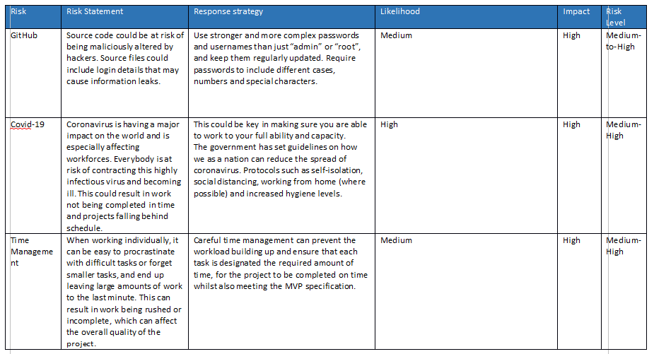

Slide 5
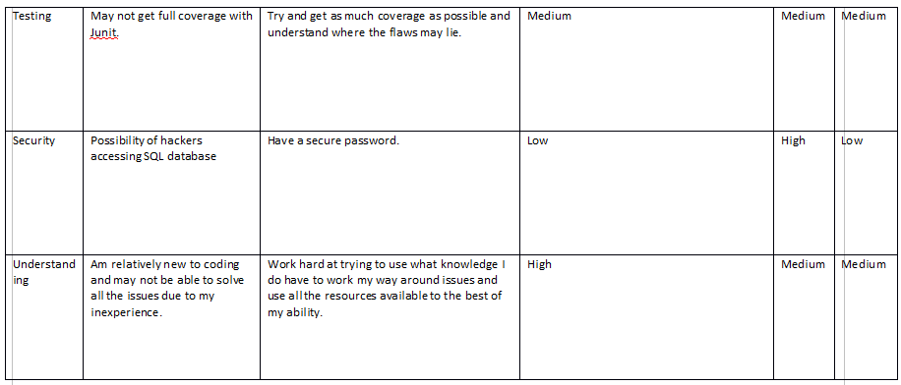

Slide 6
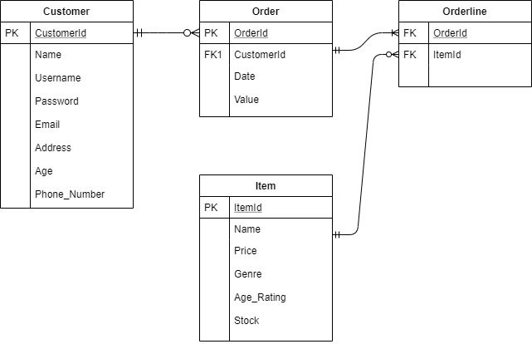
Entity Relationship Diagram (ERD)

Slide 7
GitHub/Git
Git was used for version control,
GitHub was used to store and manage repositories and other files such as Read Me.
https://github.com/sosbourneQA/ImsProject

Slide 8
Functionality
DEMO!
ImsSystem takes user inputs
Objects which are passed around between the classes of the program
Instructions are sent to methods from the controllers
The service does this by pushing the controller inputs to the appropriate DAO method, and retrieving the returned result.
DAO interacts with SQL
Customer, Items and Order functions are tested using Junit/Mockito

Slide 9
Continuous Integration (CI) Pipeline
Jenkins – is the CI Server which orchestrates rest of the pipeline
Maven – builds fat-jar
SonarQube – analysis of program
Nexus - artefact repository which stores a copy of the fat-jar
http://localhost:8080/

Slide 10
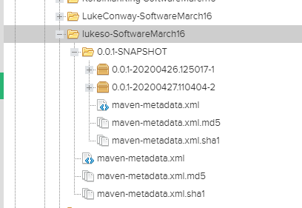
SonarQube
Nexus
Offers powerful static analysis
  92 code smells
http://35.246.55.156:9000/projects

Slide 11
Areas to improve
Better test coverage – implement tests for order line
Improve the return function so users do not have to log in after each task
Fix all the code smells
Better work flow – e.g. make more commits to GitHub
Add a functionality that updates the total in orders depending on the sum of the order line totals

Slide 12
Questions?

